Slide 1
IRoC-U24
TEAM DYAUS
PROPOSAL PRESENTATION
PROPOSAL PRESENTATION TEAM DYAUS
TEAM DYAUS
TEAM ID : 10072

Slide 2
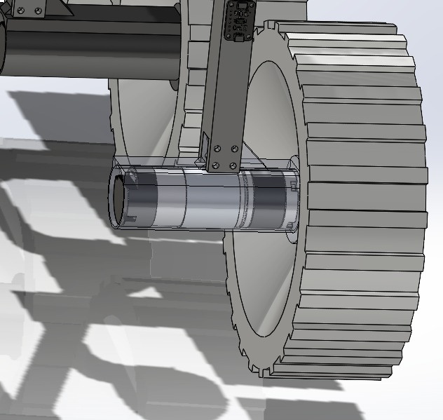
IRoC-U24
Rover Mobility and Control
Powering the Wheels
Independent DC motors power all six wheels.
Enables precise control over speed and torque for adaptive terrain navigation.
Enhances turning capabilities for obstacle avoidance, especially on slopes.
Dynamic control ensures optimized traction, stability, and agility.
Adaptability to Varying Terrain: The rover can effectively traverse diverse landscapes by adjusting wheel speed and torque.

Slide 3
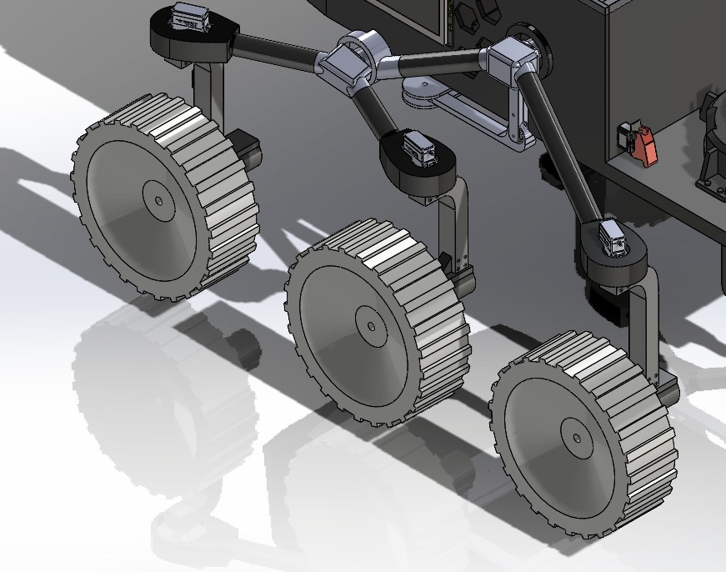
IRoC-U24
Steering and Suspension System
Steering Mechanism and Suspension Design
Sophisticated steering system with dedicated servo motors for precise and independent steering.
Holonomic drive capabilities for movement in all directions.
Motorized steering minimizes wear and tear, ensuring long-term reliability.
Rocker-Bogie Suspension with a differential for terrain adaptability and body stabilization.
Differential action spreads the vehicle load across all six wheels, minimizing ground pressure.
Holonomic drive allows agile movement in confined spaces, essential for exploration.

Slide 4
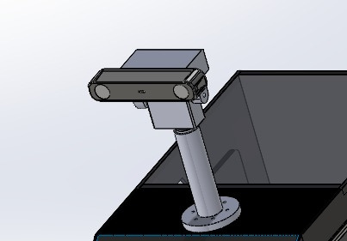
IRoC-U24
Sensing and Navigation
Sensing, Perception, and Navigation
YOLO-based algorithm for real-time obstacle detection.
Stereo depth camera enhances perception capabilities.
Algorithmic Path Planning using Follow The Gap (FGM) method for obstacle avoidance.
Comprehensive design for autonomous navigation in extraterrestrial environments.
Rover's adeptness in overcoming challenges through robust chassis, suspension, steering, mobility, and sensors.
Further details on obstacle identification, algorithmic path planning, and rover design in the full report.

Slide 5
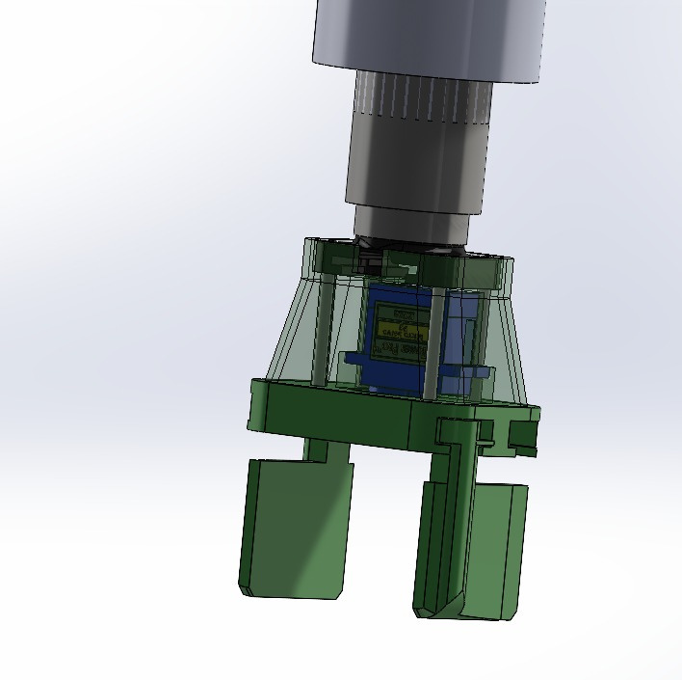
IRoC-U24
Sample Pick-and-Place Mechanism
Target Identification and Gripper Design
A specialized camera on the rover captures coordinates of the sample tube for precise identification.
Inverse kinematics enable the gripper to navigate and pick up the test tube accurately.
Gripper design includes adjustable fingers with rubber pads for a secure hold.
Frictional and compressive forces aid in holding and lifting the tube.
Gripper reorients to avoid collisions during tube placement in the container.

Slide 6
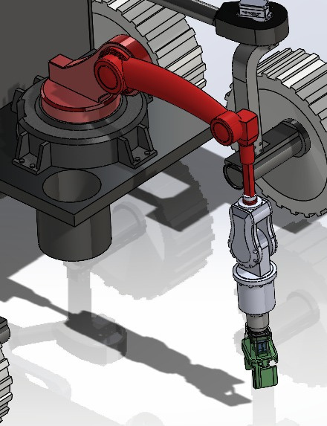
IRoC-U24
Picking, Loading, and Mobility
Picking and Loading on Rover Chassis
The 4-DOF manipulator arm moves precisely to the identified tube location.
Gripper securely holds and lifts the sample tube onto a designated area on the rover chassis.
Rover initiates autonomous traversal only after loading the sample tube.
Measures to secure the manipulator arm during rover mobility to avoid interference.

Slide 7
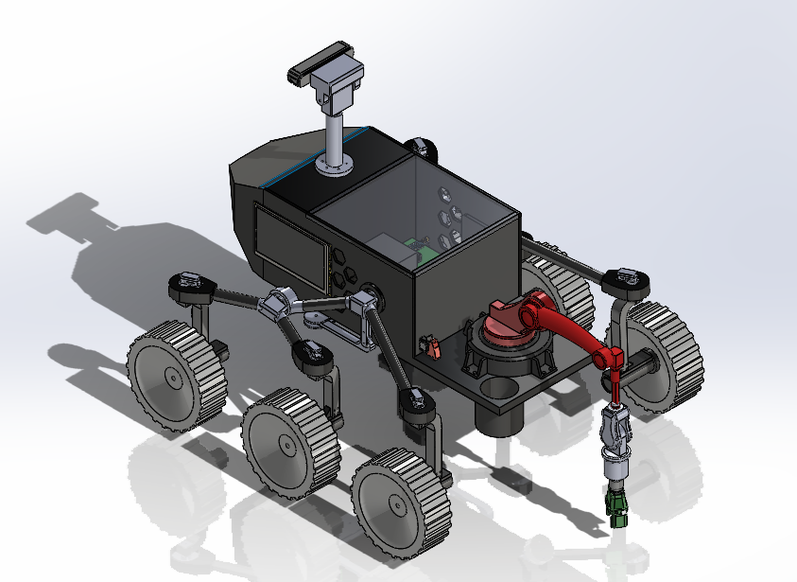
IRoC-U24
Target Location Identification, Unloading, and Coordination
Target Location Identification and Coordination
Sensors and rover camera identify the target location during traversal.
Manipulator arm positions itself over the marked circle at the destination.
Tube is dropped into the marked circle with precision.
Coordination and control involve kinematic equations, sensor feedback, and programming algorithms.
Safety measures, including force and torque sensing, handle uncertainties and unexpected conditions.

Slide 8
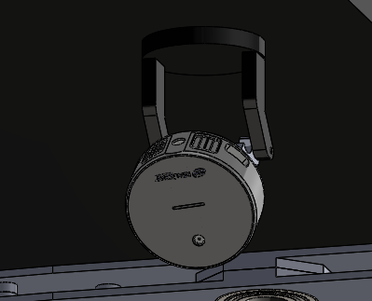
IRoC-U24
Emergency Response System Overview
Unforeseen Challenges and Safety Measures
1. Unexpected Terrain Changes
Onboard Camera and TOF Lidar continuously map terrain.
Rover stops and reviews path in case of significant terrain deviation.
2. Sensor Malfunction
Redundancy for obstacle and crater detection.
Seamless switch to backup sensors in case of visual sensor failure.
3. Power Loss
Battery Monitoring System for continuous voltage monitoring.
Emergency shutdown below threshold; automatic return if critical.

Slide 9
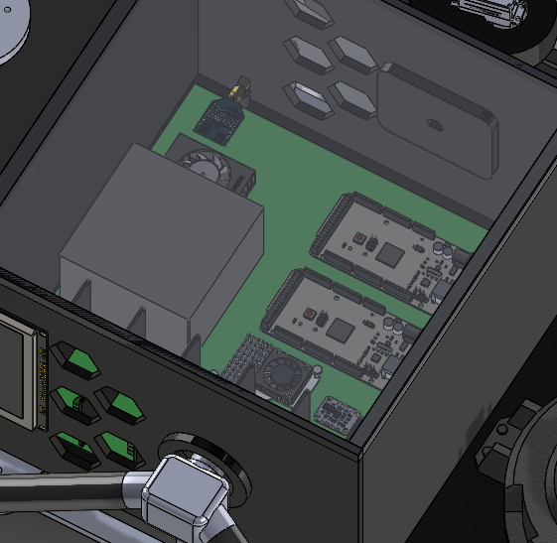
IRoC-U24
Emergency Response System Overview
Communication and Obstacle Handling
4. Communication Breakdown
Pre-program autonomous behavior during communication loss.
Return to normal operation upon communication restoration.
5. Obstacle Jamming
Sensing system detects abnormal resistance.
Rover attempts to adjust path or enter safe mode;
calls for help if necessary.
6. Obstacle Blocking Sample Tube Pickup
Sensors on manipulator arm detect obstacles.
Continuous monitoring during pickup; arm adjusts trajectory or halts operation.

Slide 10
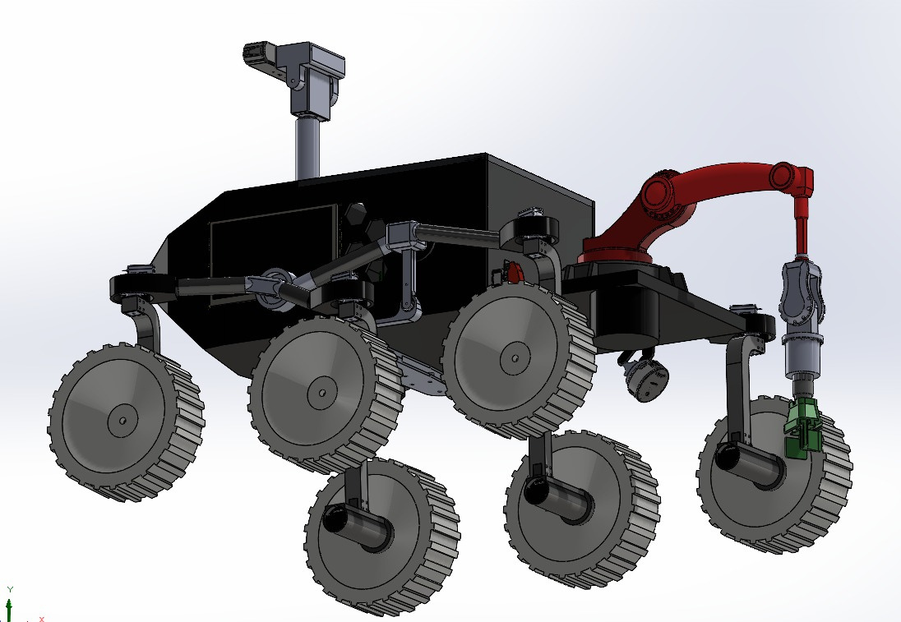
IRoC-U24
Emergency Response System Overview
Gripper and Arm Safety
7. Gripper Malfunction or Slippage
Force and Gripping Feedback Sensors for controlled gripping.
Emergency response for excessive force; re-gripping initiated if slippage is detected.
8. Loss of Visual Identification for Finish Position
Backup Visual Sensors and Localization System for redundancy.
Continuous monitoring with multiple sensors; system adjusts in case of difficulty in identification.

Slide 11
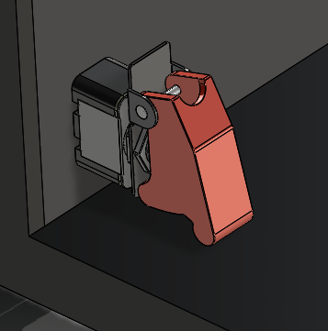
IRoC-U24
Emergency Response System Overview
Gripper and Arm Safe
9. Power Failure or Manipulator Arm Dysfunction
Emergency Power Supply and Fail-Safe Mechanism for critical systems.
Fail-safe ensures safe position in case of dysfunction.
10. Mechanical or Electronic Failure of Rover
Integration of physical or electronic kill switch.
Manual or remote activation for controlled shutdown in case of failure.

Slide 12
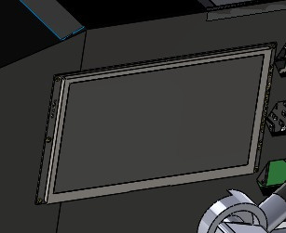
IRoC-U24
Emergency Response System Overview
Comprehensive Safety Measures
1. 7-Inch Touch Screen Integration
Real-time updates on motor RPM, battery voltage, and current.
Intuitive GUI for user interaction and dynamic monitoring.
2. Heatsink for Thermal Regulation
Strategically employed heatsinks prevent overheating.
Efficient thermal regulation ensures reliable and efficient rover functioning.
Rationale for Emergency Response System
Reliable, safety-oriented response system with
redundant sensors and fail-safe designs.
Real-time monitoring and adaptation to changing conditions.
Redundancy enhances system resilience and minimizes failure risks.
Autonomous decision-making capability in emergencies for enhanced mission success and safety.

Slide 13
IRoC-U24
Obstacle and Crater Identification Algorithm
YOLO and Stereo Depth Camera Integration
1. YOLO-based Object Detection
YOLO algorithm for fast and accurate real-time object detection.
Splits images into a grid, facilitating quick decision-making.
Discriminates objects based on size, shape, color, adding sophistication.
2-DOF camera increases field of view (FOV) for enhanced perception.
2. Crater Detection and Depth Visualization
YOLO locates craters; stereo depth camera provides size estimate.
Depth camera accurately measures distances for navigation.
Three-dimensional visualization for texture and depth information.

Slide 14
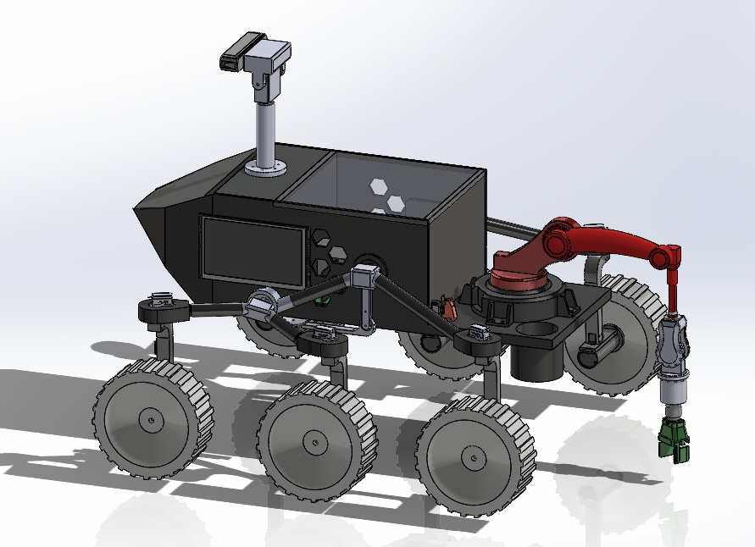
IRoC-U24
Obstacle and Crater Identification Algorithm
3. Intelligent Path Planning
YOLO and depth camera data inform real-time decisions.
Adaptive color recognition enhances perceptual skills.
Spatial information processed in navigation system for obstacle-free path.

Slide 15
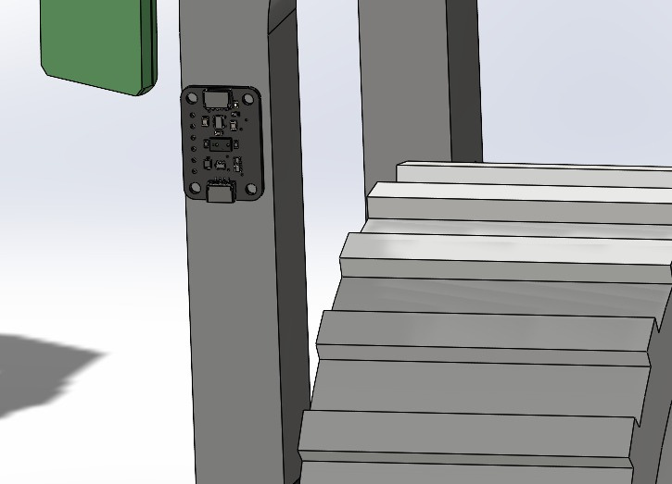
IRoC-U24
TOF-Based LIDAR Laser Distance Sensors
TOF-Based LIDAR for Fail-Safe Operation
1. TOF-Based LIDAR Laser Distance Sensors
LIDAR sensors on all six wheels create real-time terrain maps.
Laser beams measure object distances, adding rapid obstacle detection.
Complements YOLO-based object detection, acting as a fail-safe.
Enables near real-time responsiveness crucial for challenging terrains.
2. Comprehensive Rover Perception System
Integration of YOLO, stereo depth cameras, and TOF-based LIDAR.
Ensures informed navigation and collision avoidance.
Provides redundancy for object detection in varying terrains.

Slide 16
IRoC-U24
Path Planning Algorithm
Fast Gap Method for Efficient Obstacle Avoidance
1. Motion Planning and Obstacle Avoidance
Gap-based strategy prioritizes the largest gap for obstacle avoidance.
Angle of avoidance calculated using equidistant points from obstacles.
Monte Carlo simulation and real-world tests validate algorithm effectiveness.
2. Fast Gap Method (FGM) and Fast Obstacle Circle Method (FOCM)
FGM introduced for efficient navigation around obstacles.
Comparison using Monte Carlo simulation shows FGM provides safer paths.
Python-based independent nodes implement both FGM and FOCM.
The Fast Gap Method ensures safer navigation. The comprehensive perception system, including YOLO and LIDAR, coupled with adaptive recognition and intelligent planning, enhances decision-making. Safety is ensured through sensor redundancy and fail-safes, while multiple technologies improve obstacle identification. The rover demonstrates real-time adaptability and informed decision-making for efficient navigation across diverse terrains.

Slide 17
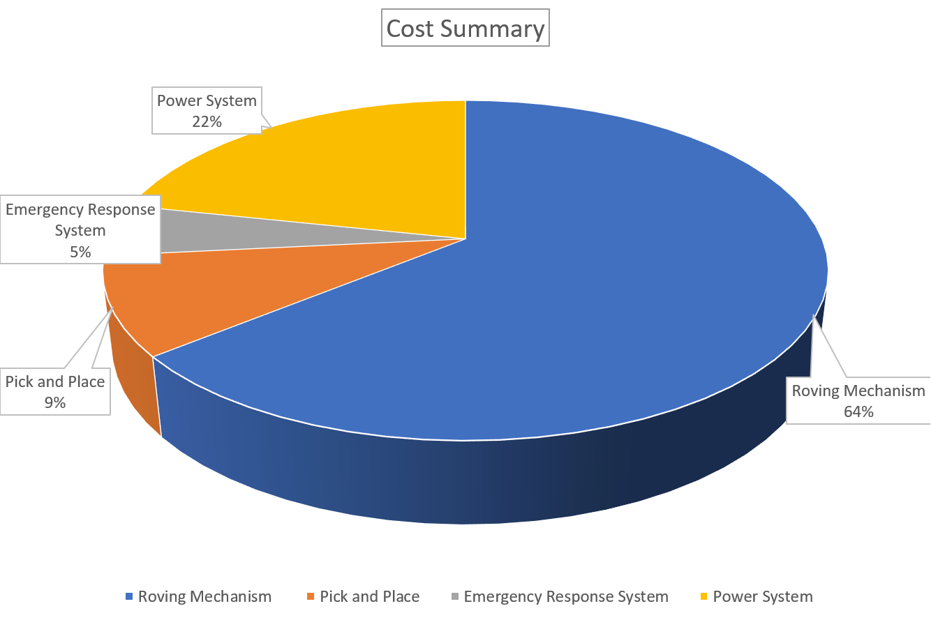
IRoC-U24
Cost Budget
8,000-12,000
40,000 - 60,000
1,30,000 - 1,50,000
18,000-25,000
Total: 1,90,000 to 2,20,000 INR

Slide 18
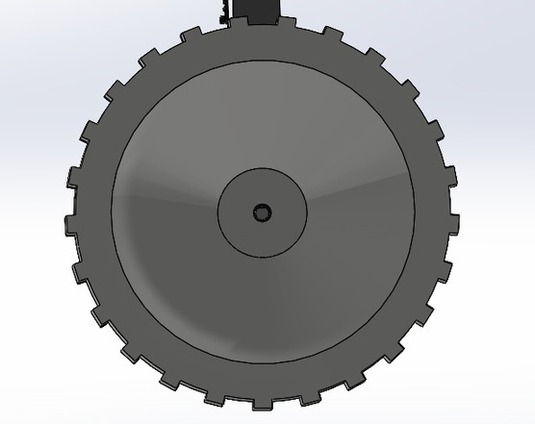
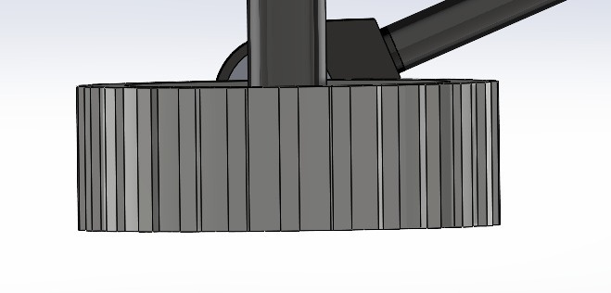
IRoC-U24
Wheel Design Innovation
Innovative Wheel Design for Optimal Performance
The wheel design prioritizes key requirements such as grip, stability, high strength-to-weight ratio, durability, and replaceability. Employing 3D printing with PETG, the design integrates innovative characteristics and facilitates the inclusion of motor mounts. To enhance friction, a rubber sleeve is utilized, maximizing power transfer to the ground for improved rover movement, steering, and braking, Optimal dimensions, including a 22cm diameter and 8cm thickness, ensure proper motor placement, torque utilization, stability, and pressure distribution. Fin-like structures on the wheel exterior enhance grip and relieve stress from the inner wheel, aiding in the secure fitting of the rubber sleeve.

Slide 19
IRoC-U24
Steering Mechanism Advancements
Precision Steering for Enhanced Maneuverability
1. Motorized Steering
Dedicated servo motor for each wheel's steering motion.
Minimizes wear and tear, ensuring rover mobility throughout its mission.
Holonomic drive capability for independent maneuvering in confined spaces.
2. Reduced Wear and Tear
Minimized stress on wheel components for prolonged operational life.
Enhanced longevity, ensuring continuous rover mobility.
3. Holonomic Drive Capability
Independent maneuvering for navigation through confined spaces.
Crucial for scientific experiments and precise exploration movements.
Enables agility and adaptability in varied exploration scenarios.

Slide 20
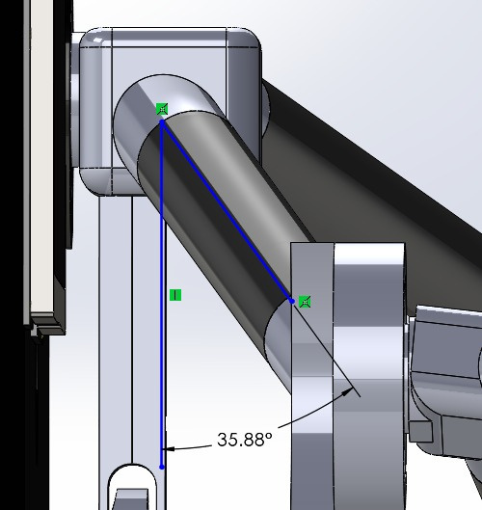
IRoC-U24
Rocker Bogie Suspension Optimization
Novel Rocker Bogie Suspension Configuration
1. Angled Links with 36-Degree Orientation
Departure from traditional 90-degree configuration for weight distribution.
Optimizes stress distribution, enhancing stability and performance.
Tailored engineering solution for challenging terrains, particularly off-road scenarios.
2. Efficiency and Adaptability
Innovative 36-degree angle introduces efficiency in load dynamics.
Improved mobility and reliability in rugged landscapes.
Marks a new era in addressing challenges posed by challenging terrains.

Slide 21
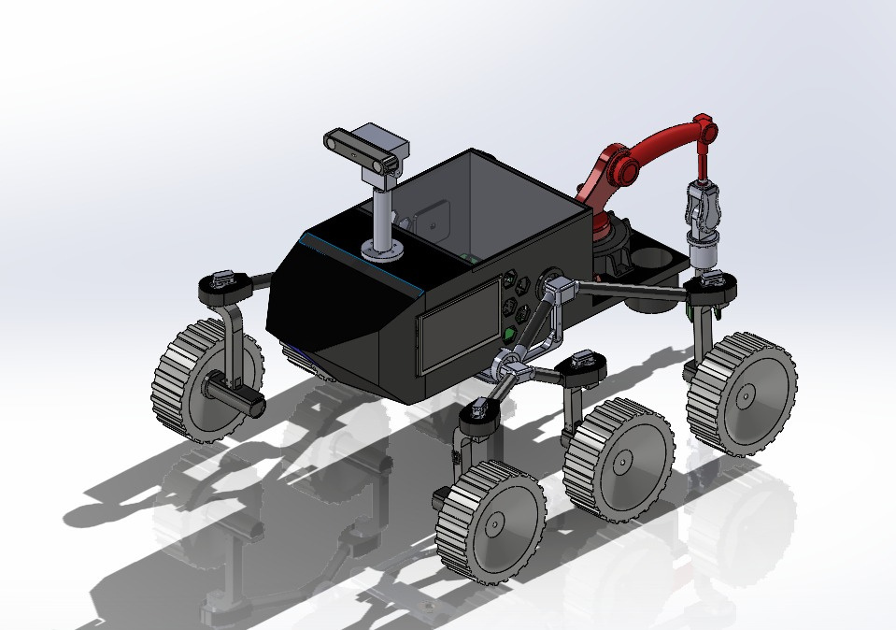
IRoC-U24
Rocker Bogie Suspension Optimization
Novel Rocker Bogie Suspension Configuration
3. Engineering Paradigm Shift
Departure from tradition introduces adaptability and efficiency.
Reflects a nuanced sharing of forces, enhancing overall rover mobility.
Represents a novel approach to suspension design for planetary exploration.

Slide 22
IRoC-U24
THANK YOU

